Slide 1
Hartford Area
Commercial Real Estate Luncheon
A Brief Look at the American Economy:
A Few Issues
John L. Glascock, PhD, SIOR, FRICS, NAIOP
Director, UCONN Center
for Real Estate and Urban studies
University of Connecticut
8th May 2014

Slide 2
Overview
1. I’ll give us a few points to think about
2. Then 2 books and 2 ideas
  The New Geography of Jobs
  Capital
  The L-Effect
  States at Risk!
3. Finally a few conclusions
4. QUESTIONS

Slide 3
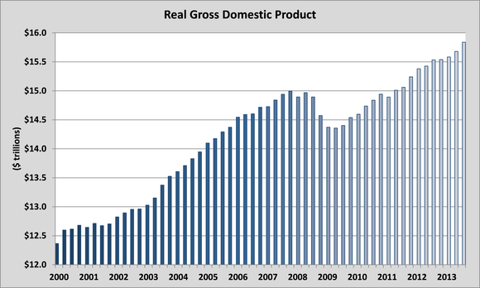
REAL GDP is at New RECORD: But Jobs?

Slide 4
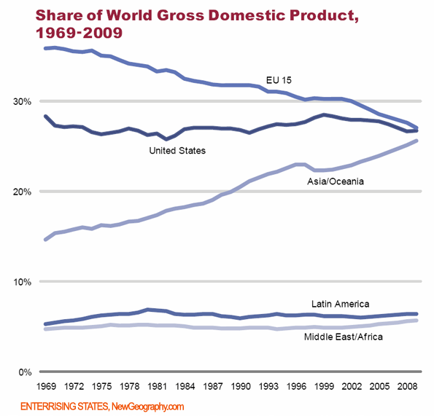
USA Holding Its Own!

Slide 5
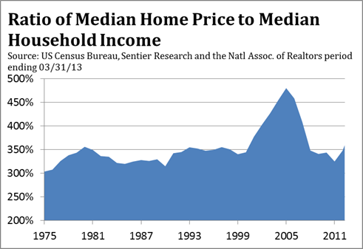
House Prices to INCOME—about right!

Slide 6
Who are driving the UE rate?
1. The young—especially men under 28
2. The relatively un-skilled?
In many ways, it is not unskilled—it is filtered out! And, government rule driven.
At UCONN, we can no longer hire a secretary who does not have a college degree. This is social sorting, not market solutions.

Slide 7
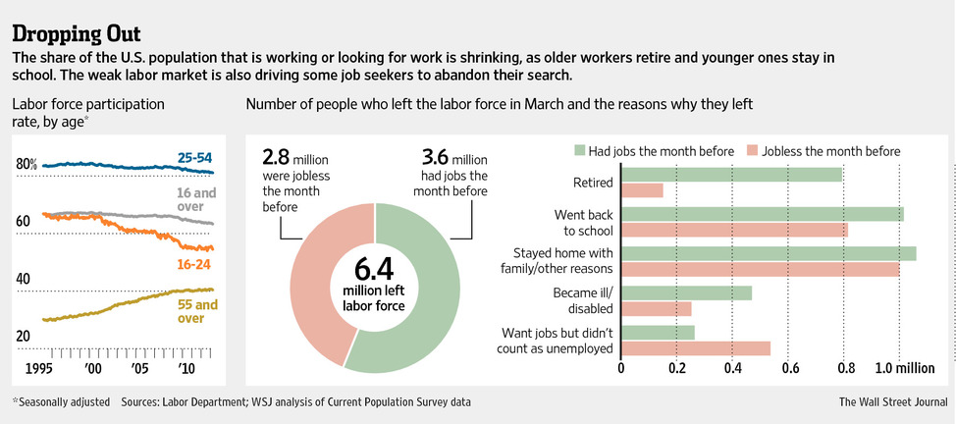
It’s the YOUNG-Undegreed!

Slide 8
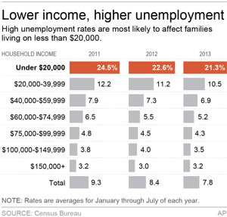
The Great Recession Hurt the Low Waged Worker Worst Of All

Slide 9
Why are low paid jobs BAD for industry?
1. Low paid jobs are usually low valued-added
secondary workers at Dollar Tree
server at McDonald’s
stocker/greeter at Wal-Mart
2. Federal/state laws make it difficult to cover costs for such a worker—take a 40 hour week and $8 per hour: wages are $16,640, BUT health care costs would be $20,000! That’s $17.62 per hour. Or if we do part-time and no benefits, it’s $8. If we force employers to pay higher wages and benefits: we will create a permanent unemployed class of workers.
3. Management and control costs are higher

Slide 10
Quick Summary so far
1. GDP is back, but employment is lagging
2. Overall, the USA is holding its own with other world areas—Europe is losing!
3. Houses are priced about right—do not expect a housing boom or construction boom
4. In a high value-added nation, benefits and management costs will force lower valued workers out of the economy unless some costs are socialized and some leeway in benefits are allowed! One last story: Columbia! Tech (any innovation) pushes reorganization.

Slide 11
Notion 1: The L-Effect
The L is the from Seattle to San Diego and then across the South and up to Washington DC, including Maryland
Except for North Dakota, all states NOT in the L have fewer children under 16 that they did in 1960! Michigan has NO county with more children under 16 than in 1960.
Add to this the coastal effect…

Slide 12
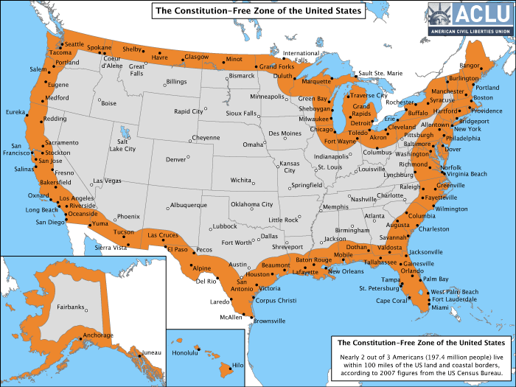
67% of all Americans Live 1.5 hours of ‘Coast’

Slide 13
L + Coastal effects
States not on the L will decline in economic value-added jobs and in at least relative population
States that have low population/fairly homogenous population and a core industry will fair reasonable well—others will suffer declining fortunes: Minnesota and the Dakotas are great places to retire to—cost of living and health care and safety.

Slide 14
More on the L and Coastal Effects
Michigan is in a for a long downturn!
Ohio/Illinois are suffering:
1900 Ohio was a top 3 per capita income state
had high value-added jobs
1960 Ohio at the bottom of top 1/3 of states
2010 Ohio in bottom 1/3 of states and falling
A short note on education—it follows growth and wealth: not the other way around!

Slide 15
Trends—let me put it together
Commercial in non-core metro areas will be very weak—except distribution
The L-States will do reasonable well in commercial and residential
We have a whole set of secondary, non-growth cities that will essentially tread water: Cincinnati, Memphis, Hartford, Cleveland, Indianapolis, Chicago!

Slide 16
Notion 2: States are Risk
Historically, CT, NY, MA, NJ and California (especially sine the 1960s) have done well.
BUT, these states are at risk:
CA first
1. California looks like the USA—some of the highest income counties and some of the lowest
2. CA is losing population and core jobs- Toyota headquarters is now in TEXAS
3. The basic Tech boom is over
4. High pensions and a unionized education labor force

Slide 17
CT wins because NY loses!
Historically CT was a high value-added technology leader and a low cost neighbor of New York.
From Pratt to GE, CT is losing core value-added jobs. Electric Boat is here—but will be reduced in size of labor force again…
Since the 1980’s, CT won due to NY’s loss: finance, venture capital, pension advising, etc.
Expect to see continued job losses!

Slide 18
Core real productive industries
Production farming 92 of every 100 in 1776
TODAY about 1! Food is good and a bargain
Trains/ Trucking and air Transport
the country is covered with rail/roads/airways
prices are dirt cheap with overnight delivery
{but it took Jimmy Carter’s deregulation effort!}
Airlines for people too—thanks Jimmy!
Autos until about 1960: after that the Co’s and Unions took the gains (society lost—that’s why foreign co’s won!)
Communications/Media/Computering
The web is replacing paper/vendors/and travel

Slide 19
What Industries are Holding the USA Back?
1. Health Services (I do not call it health care—it isn’t!)
2. Educational services (especially Higher Education)
Private Colleges graduate about 60%
State Colleges graduate about 30%
OVERALL—ABOUT 48% the UK is ABOUT 82%
What industry produces a failure rate of 52% and then charges more every year! Currently the USA system is about filtering: not education!

Slide 20
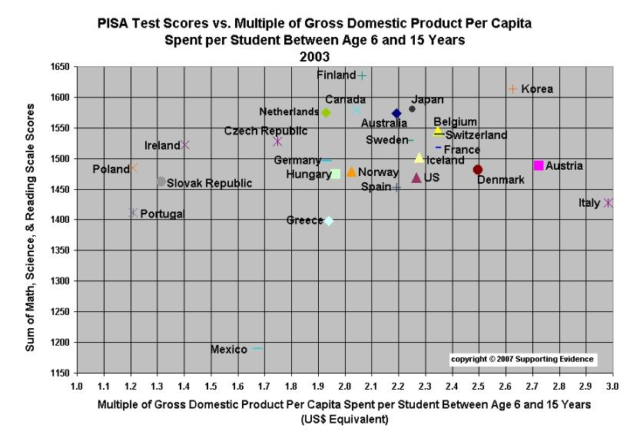
Spending and Educational Efficiency!

Slide 21
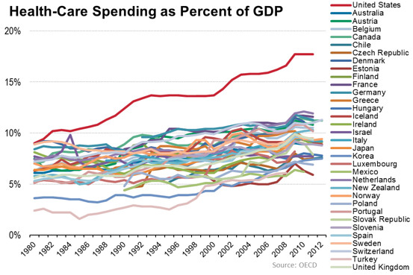
WOW! Health Care Costs

Slide 22
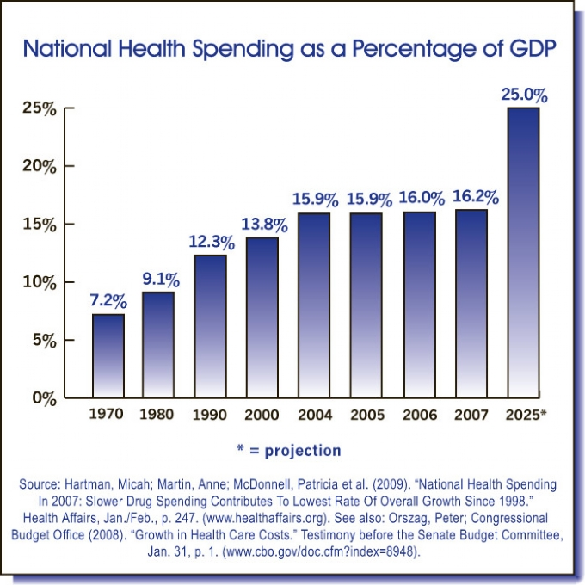
Heath Care Costs

Slide 23
Ulcers and Knee Surgery
They are caused by bugs (1958 data)! 92%
But we did not quit using surgery until 1988
Knee Surgery: Over half do not work!

Slide 24
Prostate Cancer!
P 56 Welch
New diagnoses DO NOT Lead to more lives saved.
Thus unnecessary procedures and side effects.
Finally,
we know in general: do not get prostate test!

Slide 25
Cholesterol!
1. The test that showed that Cholesterol works—
A. Did not check for inflammation
B. A re-review showed that only WHITE men under the age of 40 who had heart problems experienced any gains!...wait...what?
C. Under-estimated side effects of the drug
2. Half of all heart issues (stroke/attack) are people who have low cholesterol…C seems to be a non-factor except in special cases (then really important). Yet the profession is calling for more satins: Why? Let me read you a passage.

Slide 26
TWO quick BOOKS-read one, use the other as door stop!
The New Geography of Jobs by Moretti
fantastic—read it twice
Capital by Piketty
I thought that I’d be the first to tell you—this is bad…ok really bad! But the Economist (I got mine last night) on page 67 of the May 3rd 2014 issue tells you. Piketty is a French (closet) Marxist who cannot get over that the USA won and the French did not!
… more

Slide 27
Capital
The book is supposedly about why the 1% are there and why it will eventually kill society as we know it!
Piketty’s view is a simple 2 actor model:
capital (seed, land, machinery) workers
if r the rate of return on capital is greater than g the growth rate of the economy—then labor must get a smaller share of the pie ad eventually (well just as Marx said) either rebel or be driven to poverty.

Slide 28
My Story—amateur economist: I see the world as:
Workers, managers, entrepreneurs, capital holders and government
The key is who builds wealth and who are the 1%
Piketty says it is the capital holders
My research suggests that in the USA, is it is entrepreneurs (and E-Managers) and Professional managers!
In my world the 1% folks actually created g. In Piketty’s world g seems to come from nowhere! And seems to be over. If we do not motivate the entrepreneurs, he will be right. So if we were to listen to him, he would turn out right. If we ignore him, he will be wrong. The good news is that we usually ignore the Europeans and especially the French.

Slide 29
A final Thought
Growth seems to come from entrepreneurs and clustering of industry.
Wealth and real gains do not seem to come from stocks after they are public. Thus, why allow capital gains taxes to skew income? By the way, capital gains income is the most skewing part of the American system—that is government driven not market driven. A ten year hold for capital gains would serve risk sharing and avoid games to lower income taxes.

Slide 30
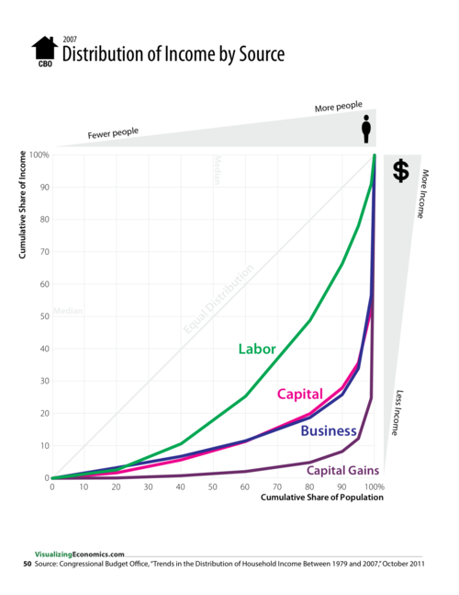
Distribution of income

Slide 31
Data on Serial Correlation of Family Firms
5.5 million family firms in the USA
57% of USA GDP
Employ 63% of the workers
35% of the S&P 500 (businessweek, 2006)
40% pass to second generation
13% pass to third generation
3 % pass to the 4th generation (Ali, Chen and Radharishnan, 2007, Jo of Accounting and Economics)
By the way, family run firms are associated with greater liquidity and valuation rates

Slide 32
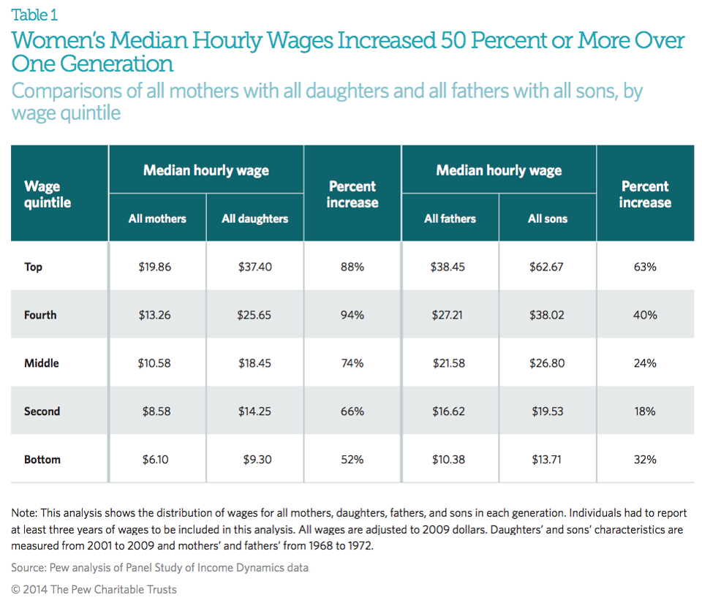
Women 68-72 to 01-09

Slide 33
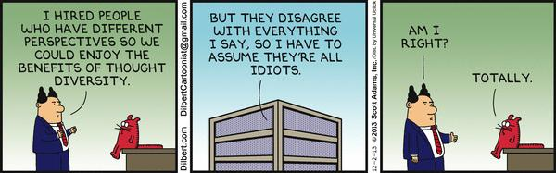
Thank You –Questions?

Slide 35
Books to Read
Crash Course, Paul Ingrassia, 2010
How We Do Harm, Otis Webb Brawley, 2011
Bad Science, Ben Goldacre, 2009
The Global Achievement GAP, 2008, Tony Wagner
Checklist Manifesto, Atul Gawande, 2009
Catastrophic Care, David Goldhill, 2013
Over-diagnosed: Making People Sick in the Pursuit of Health
Dr. H. Gilbert Welch, 2011

