Slide 1
UCONN Commercial Conference
9 May 2013
John L. Glascock, PhD, SIOR, FRICS
Center For Real Estate and
Urban Studies
University of Connecticut
Peter Gioia, CBIA

Slide 2
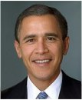
Why the Recovery is SOOO Slow!

Slide 3

Thanks to Great Friends
Catic
Cornerstone
Konover Properties and family

Slide 4
The ECONOMY
China vs USA—we do not lose unless we stop playing!
Europe has stopped playing…maybe Japan too.
Our job is to destroy and then re-create jobs
Harford – Not doing too well!

Slide 5
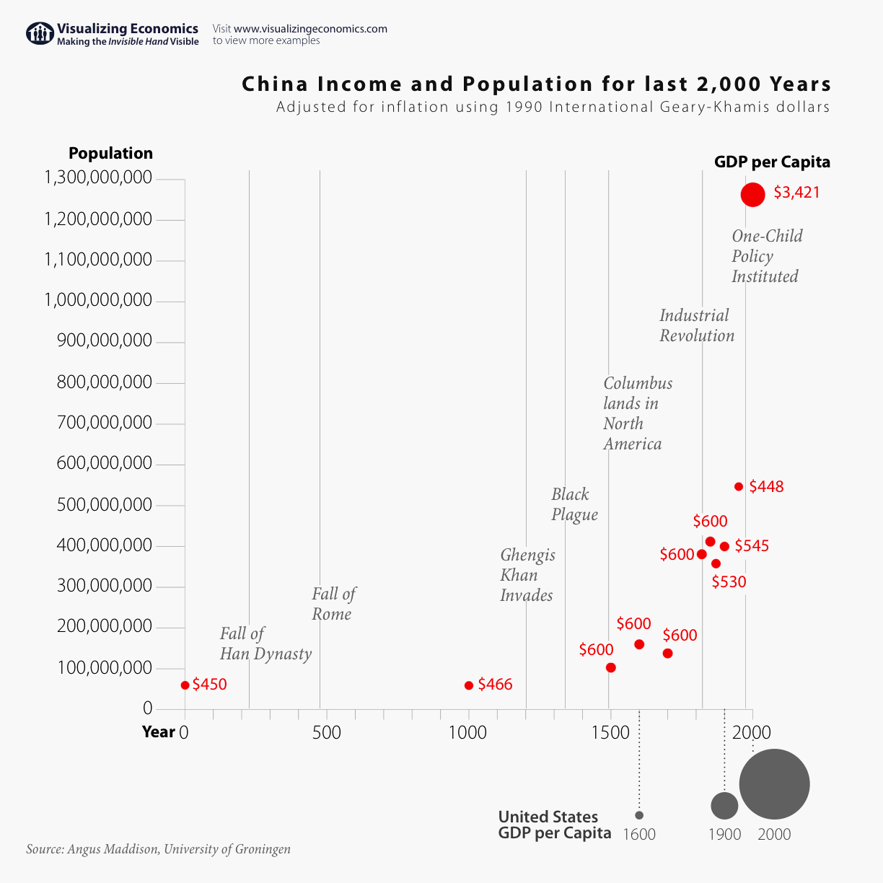
China versus USA

Slide 6
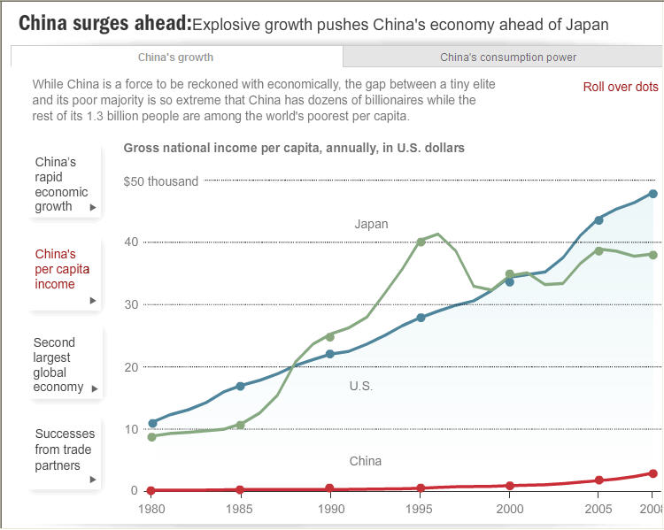
Per Capital GDP: USA, Japan & China

Slide 7
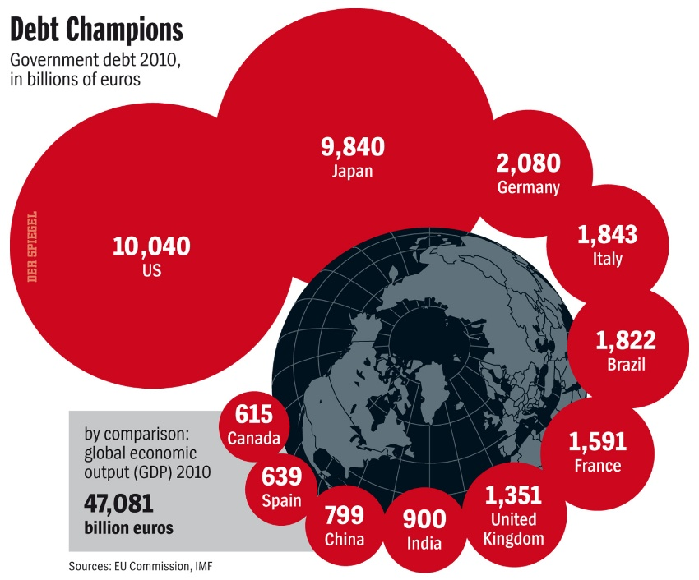
China Debt about the Same as USA!

Slide 8
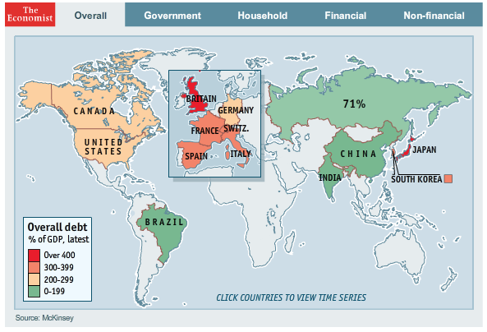
Everyone has debt
USA is about the same as Germany
UK must higher
China weaker position

Slide 9
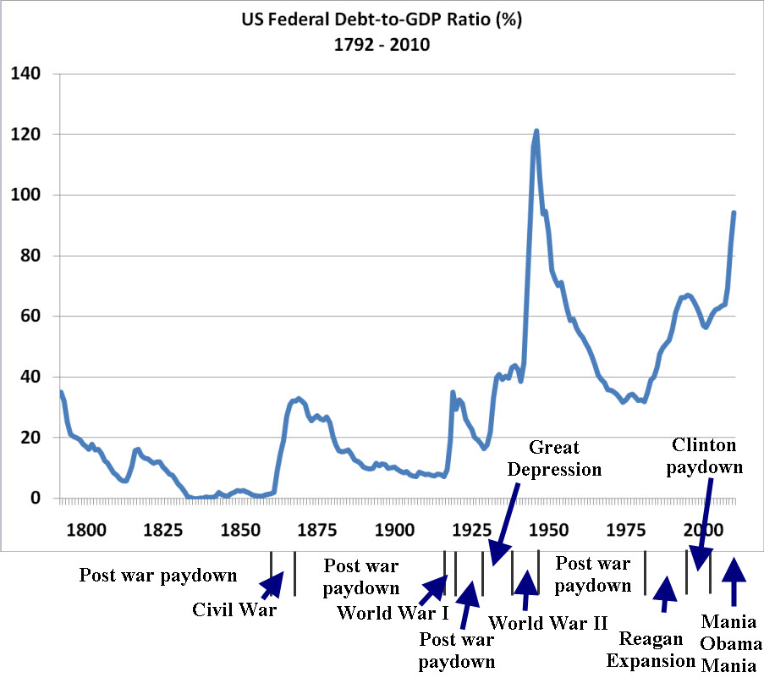
Debt to GDP, but…

Slide 10
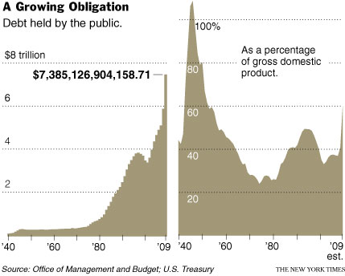
Debt not held By FED, etc…

Slide 11
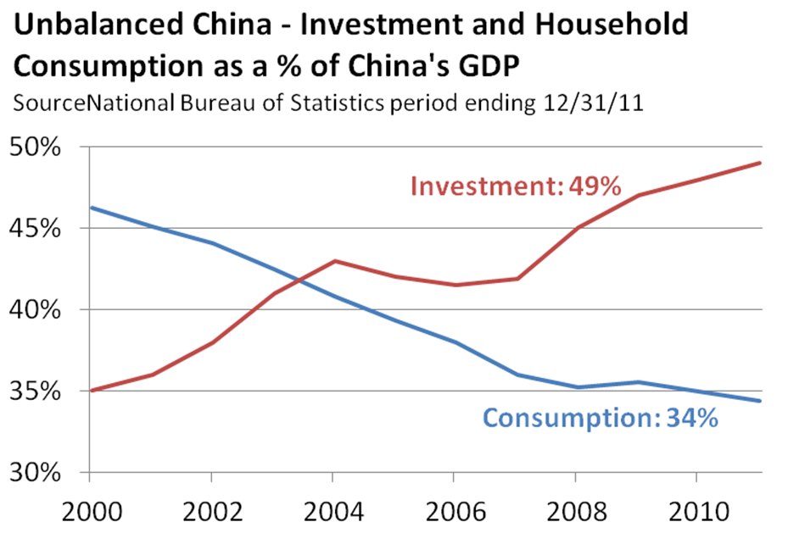
China headed toward Wasteful Crash!

Slide 12
Bank Debt to Finance Investment in China
Estimate is that about 40-60%
will never be repaid!

Slide 13
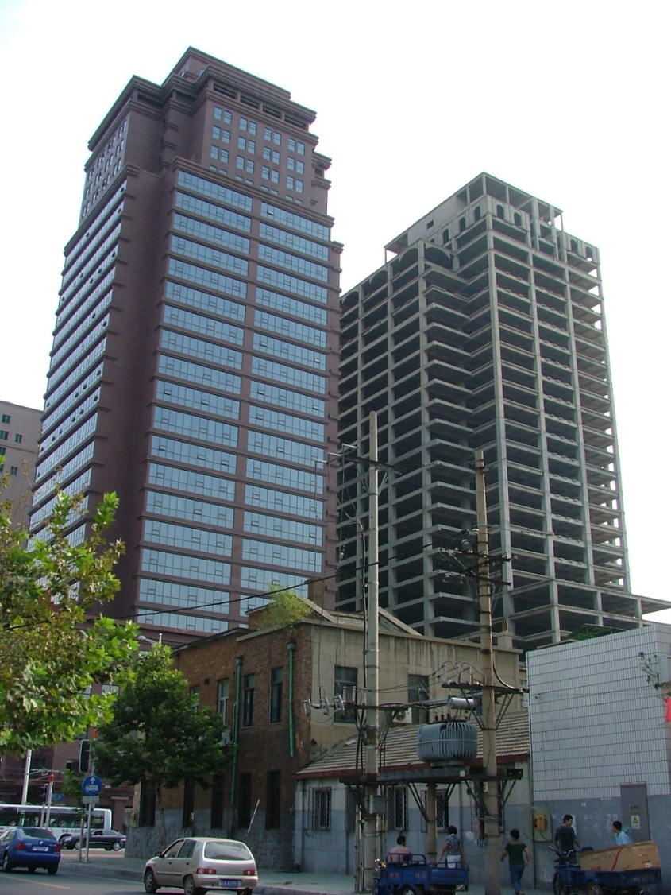
Dalian China
Building on right has been empty for about 10 years!
Many developments in China will never pay off—gov’t sponsored.

Slide 14
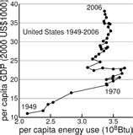
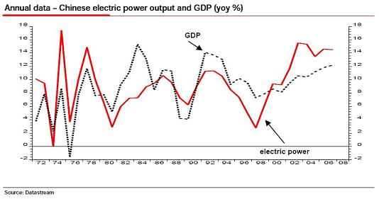
USA Beats China—energy use!

Slide 15
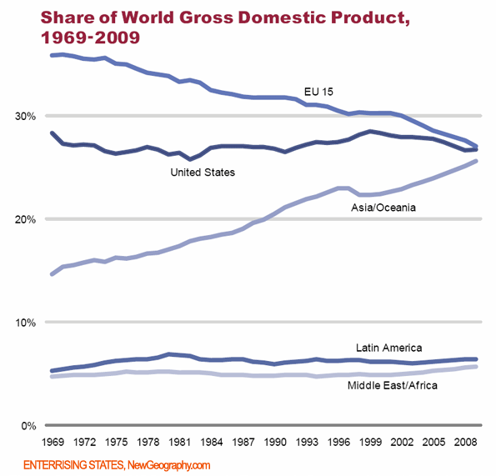
USA Doing Well—EU Downturn is NOT NEW!

Slide 16
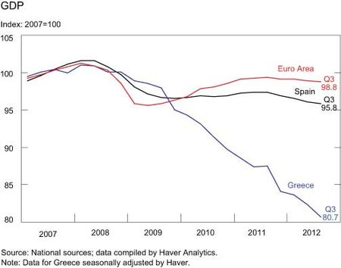
Europe is Killing Their Respective Economies

Slide 17
Lets turn to the USA
Too few people working
The key is productivity
Get rid of poor jobs
Increase share of high value-added jobs
Remember agriculture! And the UK late 1800’s

Slide 18
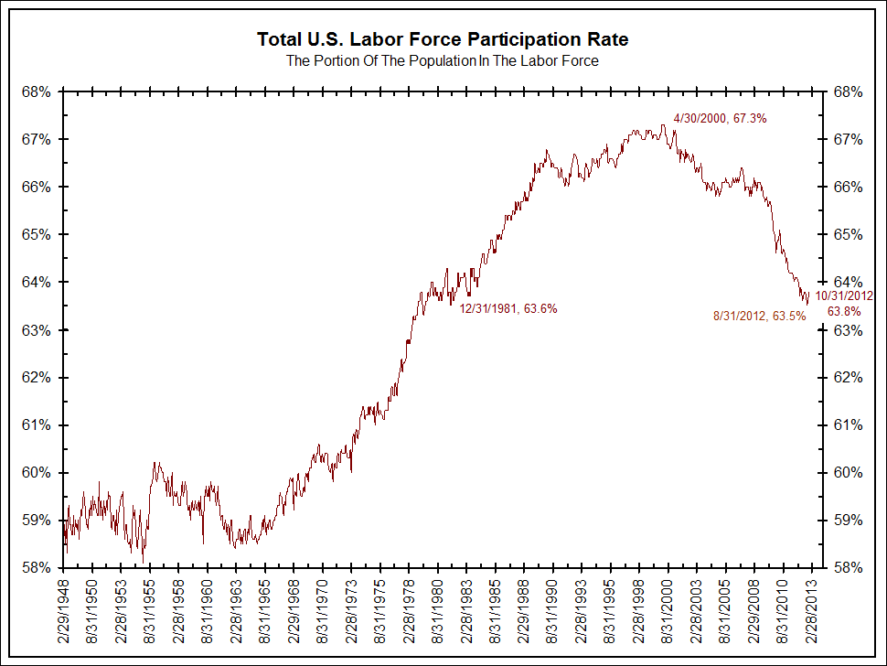
People are NOT working

Slide 19
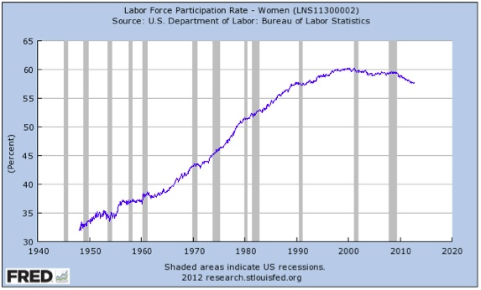
Women are NOT working NOW!

Slide 20
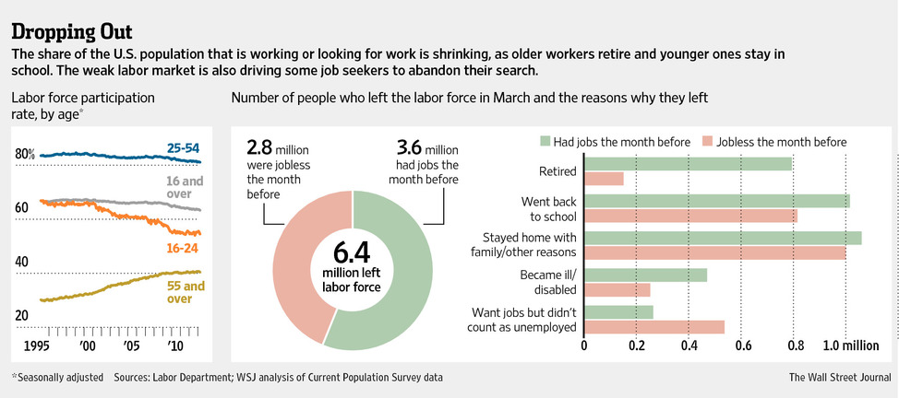
Labor Participation—too few young Working and too many elderly working!

Slide 21
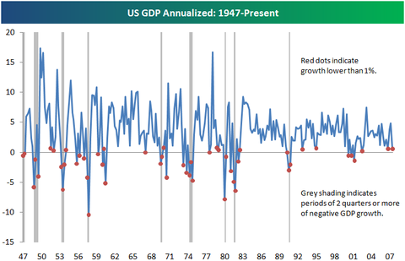
Economy tooo smooth

Slide 22
WOW! Did you Know?
See The Age of Austerity, Thomas Edsall, 2012
The deficit would be zero in 2009 if not for 5 items:
1. Economic Downturn
2. BUSH Tax cuts
3. Wars in Iraq and Afghanistan
4. Recovery Measures
5. TARP, Fannie/Freddie

Slide 23
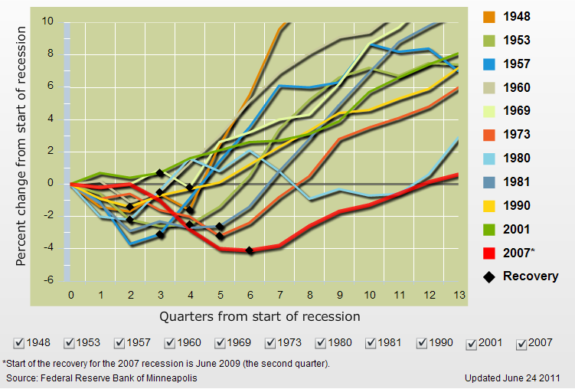
The Economic Recovery
This time
is different

Slide 24
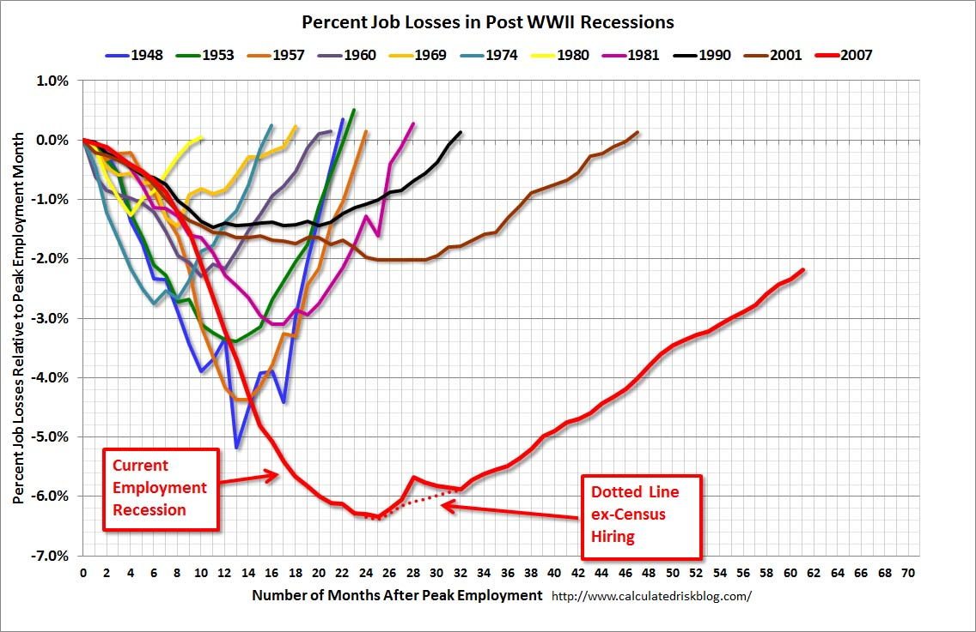
Jobs NOT just GDP is Different this time!

Slide 25
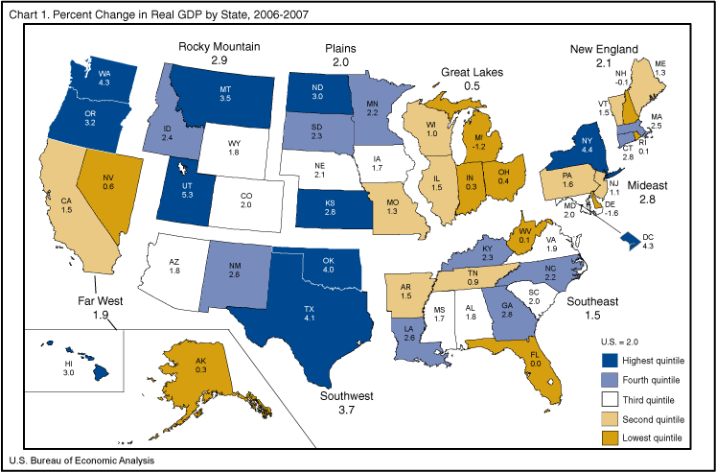
CT Doing Well, but Not Outstanding

Slide 26
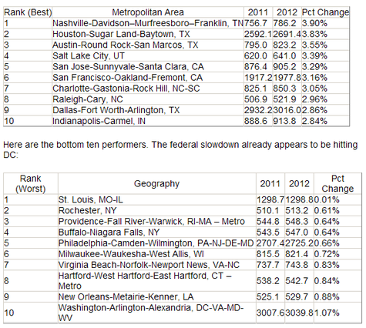
Hartford NOT doing well!

Slide 27
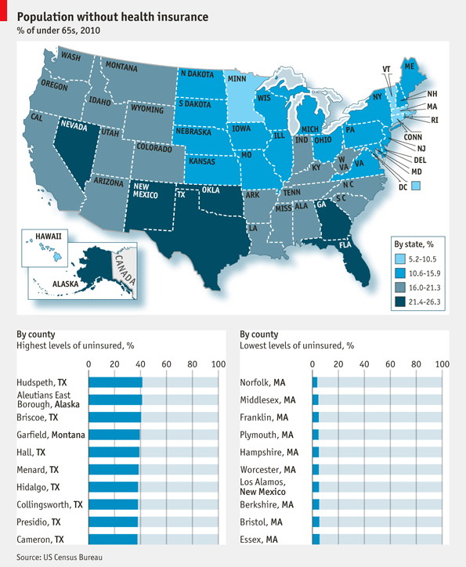
Percent w/o Health Insurance

Slide 28
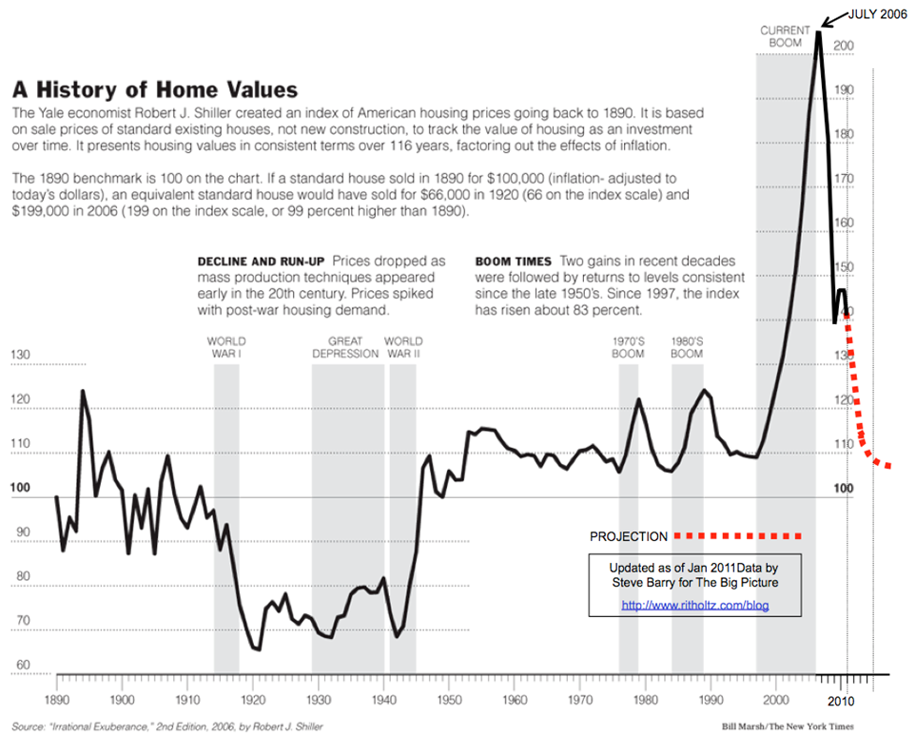
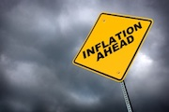
Final Thoughts—Questions?

Slide 29
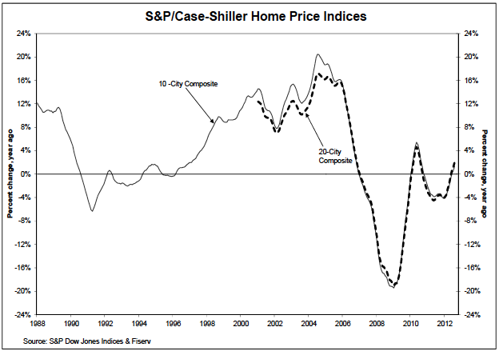
More Details Shiller Index

Slide 30
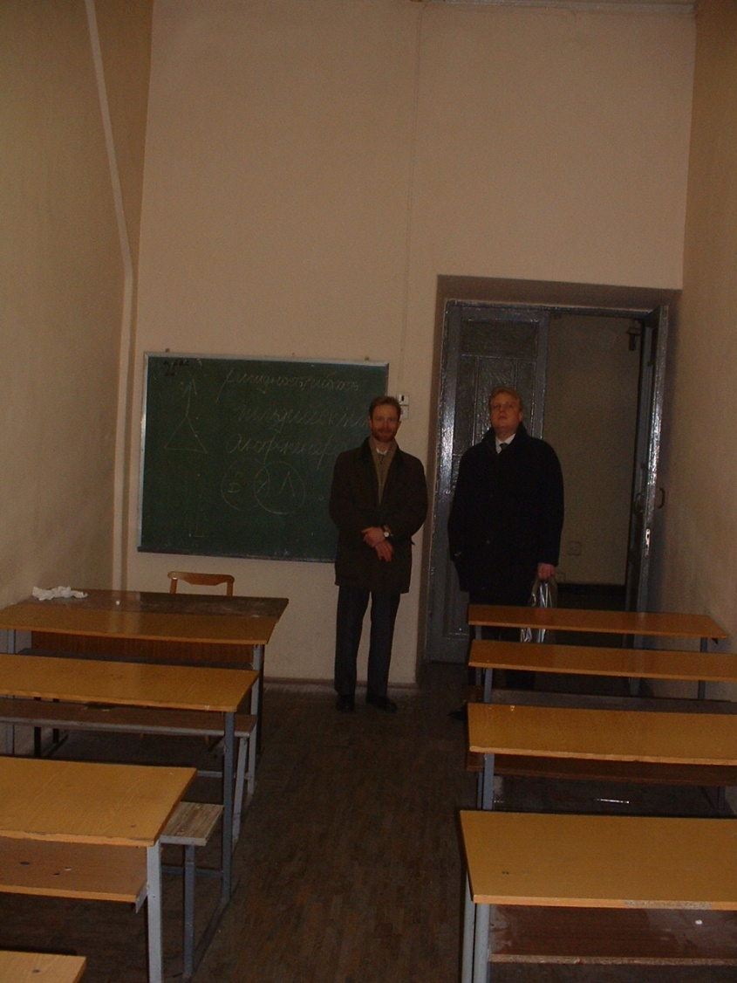
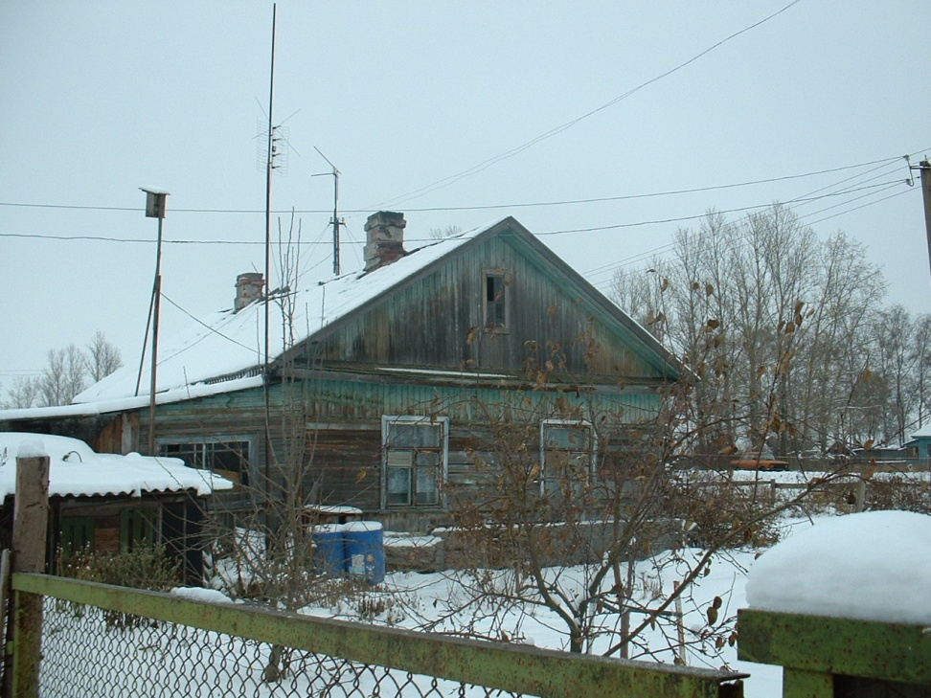
Russia

